Slide 1



Evaluating and Improving RAG Pipeline Metrics
This project aims to evaluate and enhance the performance of our RAG pipeline.
by Farid Ghorbani
FG

Slide 2
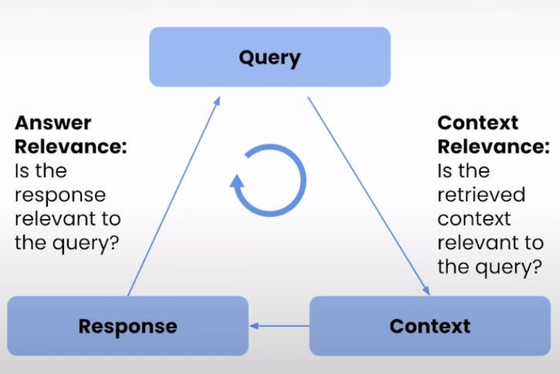
Performance Metrics Overview
Query
Context
Response
The user input that initiates the RAG process.
Retrieved information based on the user's query.
LLM output generated from the query and context.

Slide 3

Context Relevance Metrics
1
Context Precision
Measures the accuracy of retrieved context matching the query.
2
Context Recall
Evaluates the ability to retrieve all relevant contexts.
3
Context Relevance
Assesses how well the retrieved context relates to the query.
4
Context Entity Recall
Determines the ability to recall relevant entities within the context.

Slide 4

Answer Relevance Metrics
1
Accuracy and Relevance
Measures how correct and relevant the responses are to given prompts.
2
Coherence and Fluency
Assesses the logical flow and smoothness of responses.
3
Consistency
Evaluates response consistency across similar queries.
4
Robustness
Tests the model's handling of ambiguous or tricky inputs.

Slide 5
Evaluate Performance
Human Assessment
Cosine Similarity for Context Relevance
Gather feedback from users on the quality and relevance of the generated responses.
Measure the similarity between the query and the retrieved context to ensure high relevance.
ROUGE (Recall-Oriented Understudy for Gisting Evaluation) scores for Answer Relevance
Evaluate the generated answers against human-written references to assess accuracy and completeness.

Slide 6

Evaluation Process
1
Select Prompts
Choose a wide range of prompts to generate a list of queries.
2
Generate Responses
Create a function to generate context retrieval and answers for each query.
3
Evaluate Context Relevance
Assess retrieved contexts using cosine similarity calculations.
4
Evaluate Answer Relevance
Compare generated answers with reference answers using ROUGE scores.

Slide 7




Improvement Methods
Auto-merging Retrieval
Combine multiple retrieved contexts for more comprehensive responses.
Prompt Engineering
Improve prompt design to guide the model in using retrieved context effectively.
Document Chunking
Optimize chunk_size and chunk_overlap parameters for better text splitting.

Slide 8
Reevaluating Context Relevance
Context Recall
Context Relevance
Context Entity Recall
Improved ability to retrieve all relevant contexts for user queries, resulting in more comprehensive information retrieval.
Higher relevance of retrieved context to user queries, providing more pertinent and useful information.
Enhanced ability to recall relevant entities within the context, leading to more precise and informative responses.

Slide 9

Reevaluating Answer Relevance
Accuracy and Relevance
Consistency
Improved correctness and relevance of responses to given prompts, providing more accurate and contextually appropriate answers.
Increased consistency of responses over multiple similar queries, ensuring more reliable and predictable outputs.

Slide 10

Conclusion
The improvements in both context and answer relevance demonstrate the effectiveness of the implemented methods, particularly the auto-merging retrieval technique. These enhancements have led to a more robust and accurate RAG pipeline, capable of providing more relevant contexts and generating more precise and consistent responses. The project successfully achieved its objectives of evaluating and improving the RAG chatbot's performance.

